Slide 1


Download binaries
Configure Scripts
Generate Crypto
Configure Docker Services
PeerAdmin Card creation
Test the network
Install & Start BNA
Docker Swarm Network
Download binaries
Configure Scripts
Generate Crypto
Configure Docker Services
Peer Admin Card creation
Test the network
Setup Envoirnment
Generate Crypto material
Fetch-Decode & add Org2 json
Sign & Update
Spin Up Org2
Test Network
Join Org2 to the channel

Slide 2
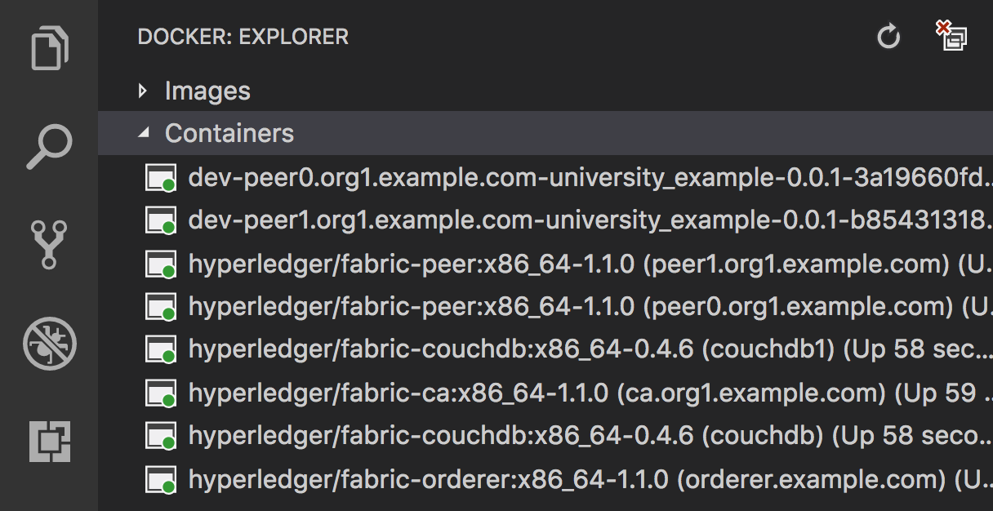
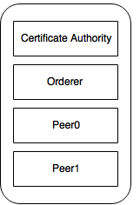
Current Setup
Peer0 + CouchDB

Slide 3
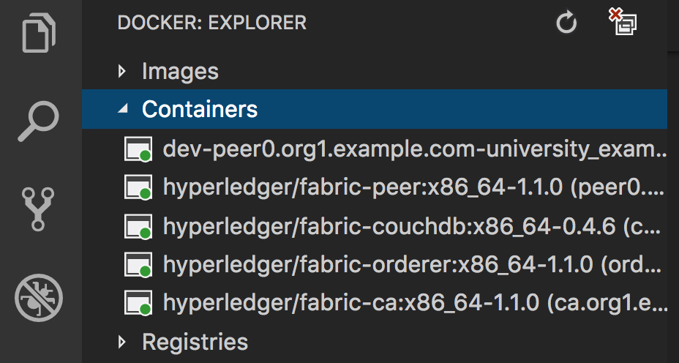
Certificate Authority
Orderer
peer0.org1
couchdb

Slide 4
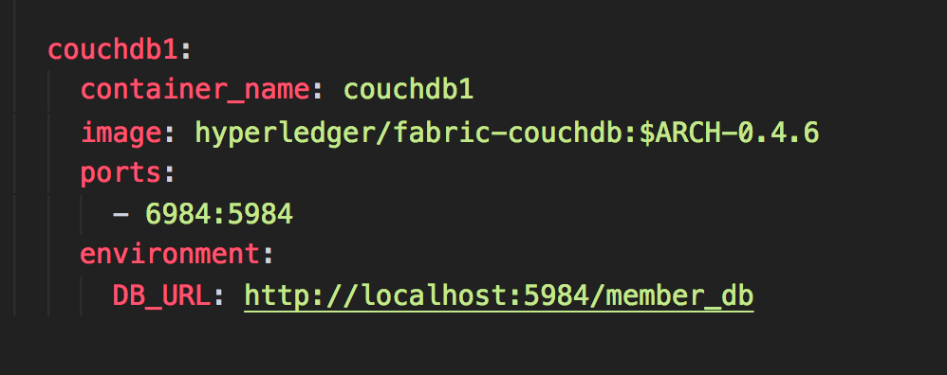

Slide 5
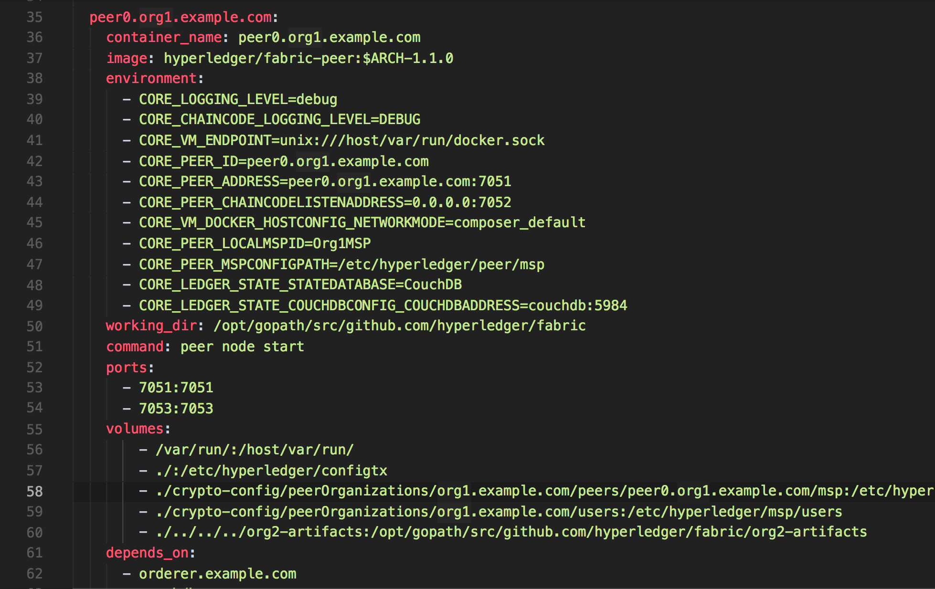

Slide 6
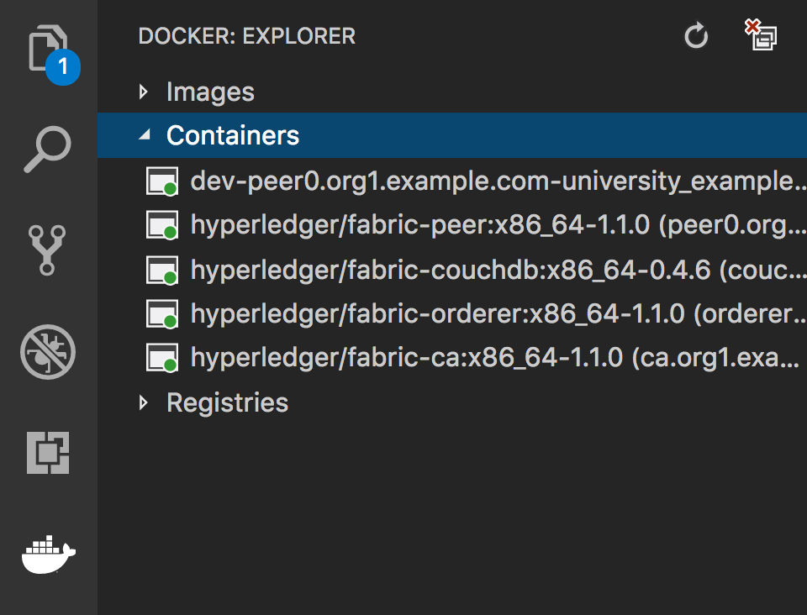

Slide 7
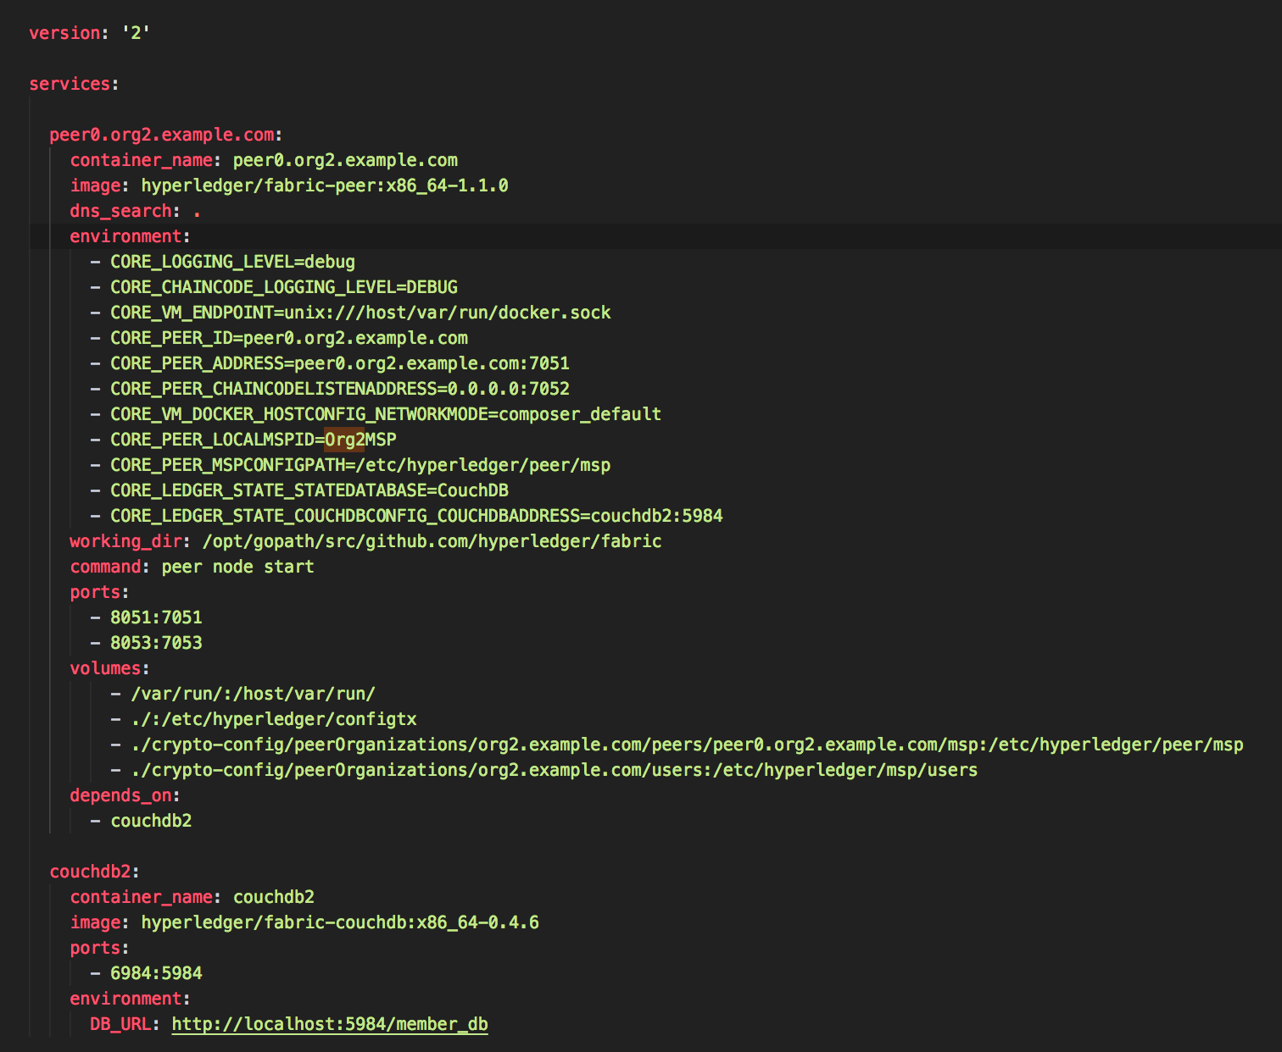

Slide 8
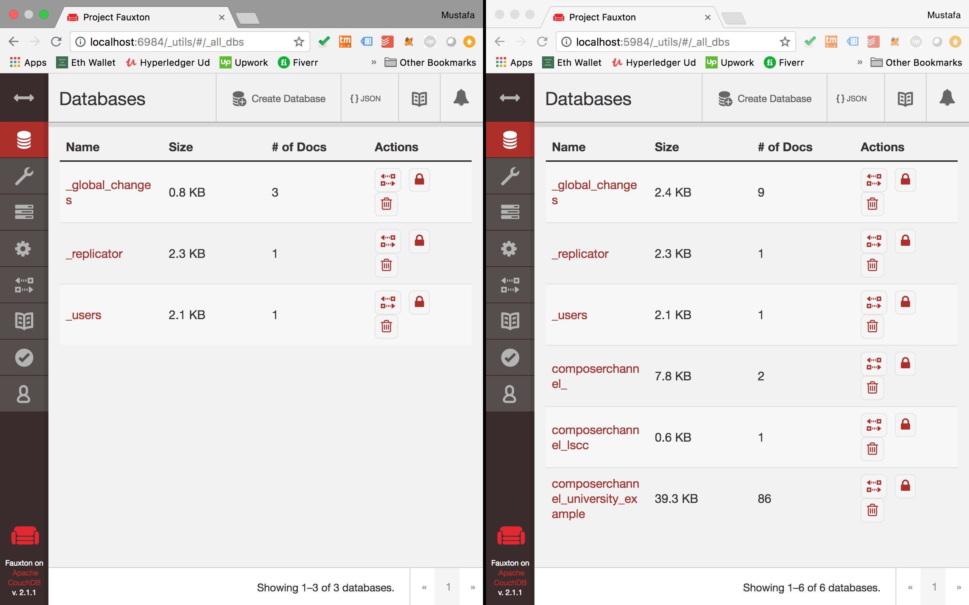
couchdb2
Couchdb

Slide 9
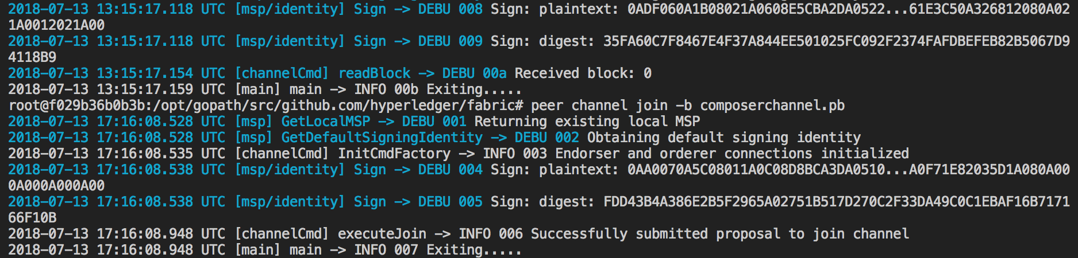

Slide 10
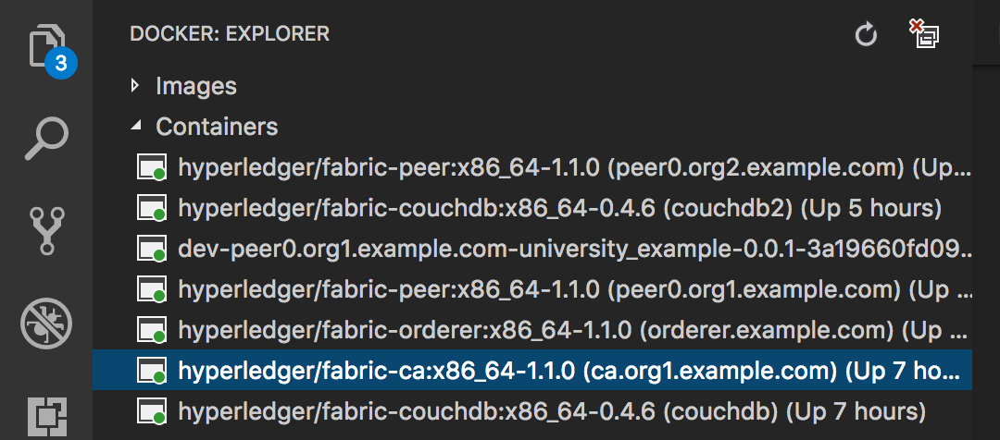
Certificate Authority
Orderer
peer0.org1
couchdb
peer0.org2
couchdb2

Slide 11
Host #1
Peer0 + CouchDB
Peer1 + couchDB1

Slide 12
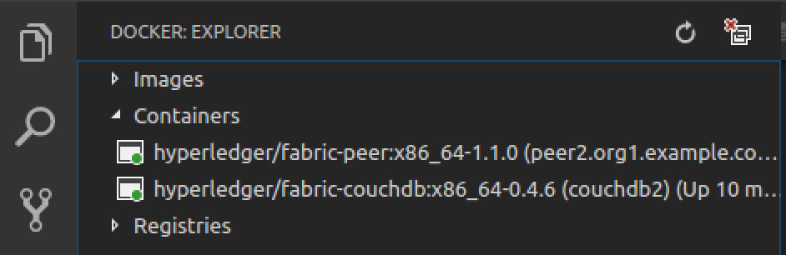
Host #2
Peer2 + couchDB2

Slide 15
Skype ID: sandeep.mishra91
Download binaries
Configure Scripts
Generate Crypto
Configure Docker Services
PeerAdmin Card creation
Test the network
Install & Start BNA

Slide 16
